Slide 1

The Code Kitchen
Code Retreat – September 2025

Slide 2
Agenda
The Goal
Orders
Recipes
Pantry
Equipment
Timers
Communication
Rating

Slide 3
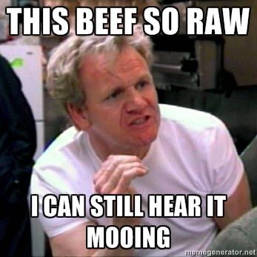
The Goal
Processing Orders
Cooking food
Teamwork!!!
Keeping our rating as high as possible
Notes:
Orders with requests will roll in
Recipes need to be followed, timing is crucial
In a kitchen, Communication is key!!!
We will work in Teams
Keeping the rating as high as possible is the goal

Slide 4
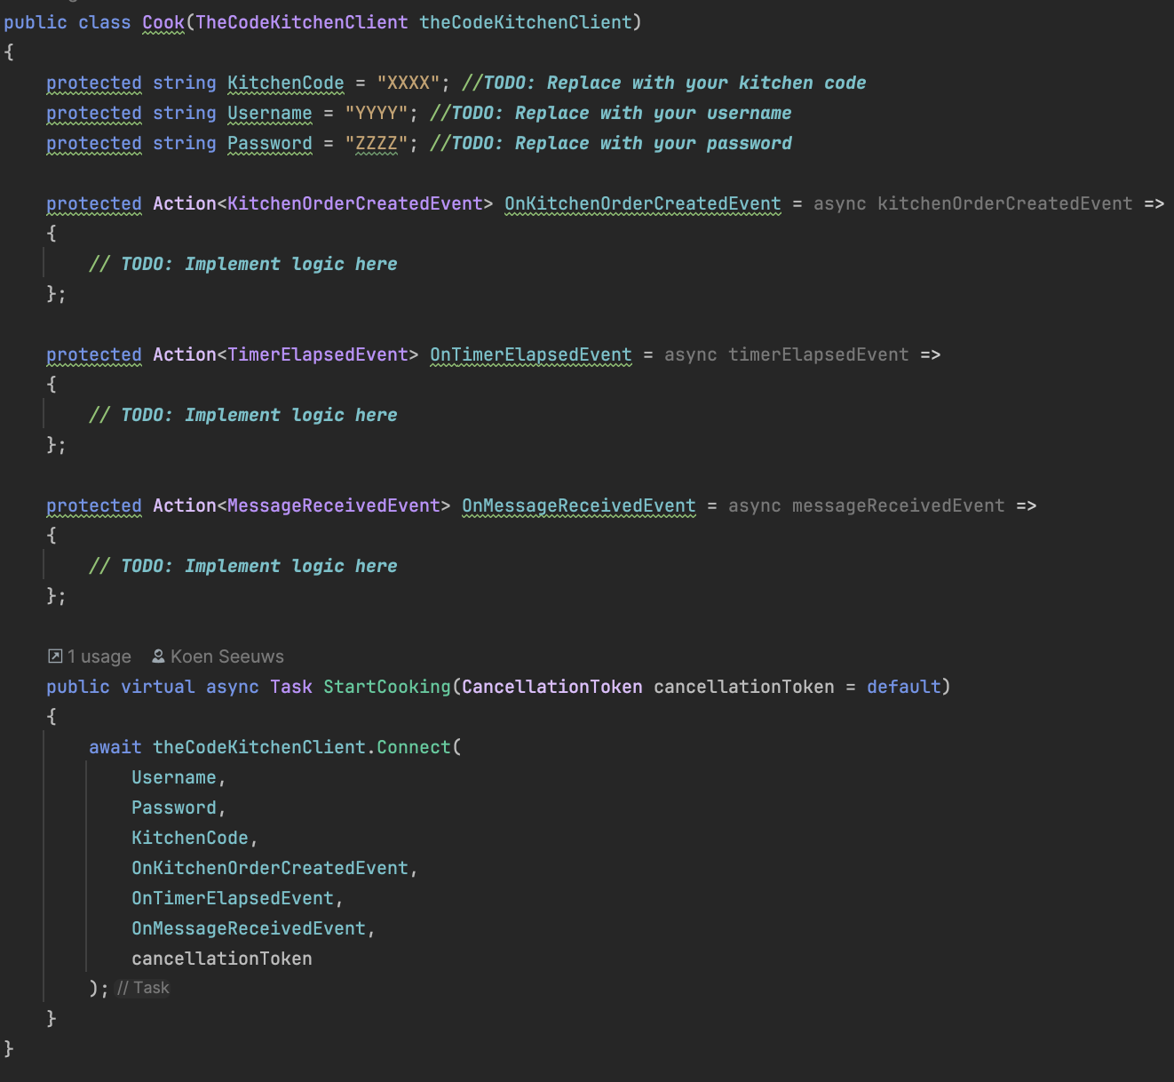
How?
Notes:
Template will be provided
Cook class needs to be implemented
There is allready client which: exposes endpoints, handles auth

Slide 5

Orders

Slide 6
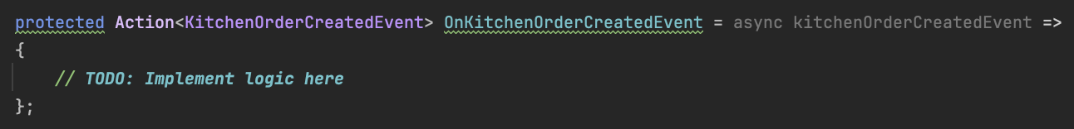
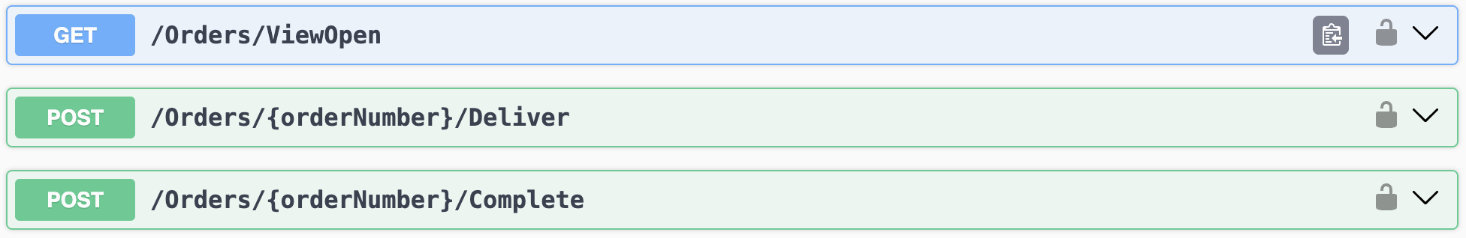
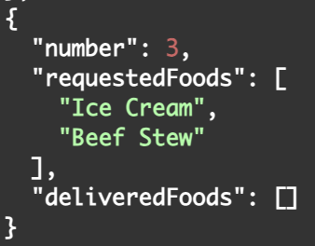
Orders
Identical for every kitchen
Always have a unique number within a kitchen

Slide 7
Recipes

Slide 8

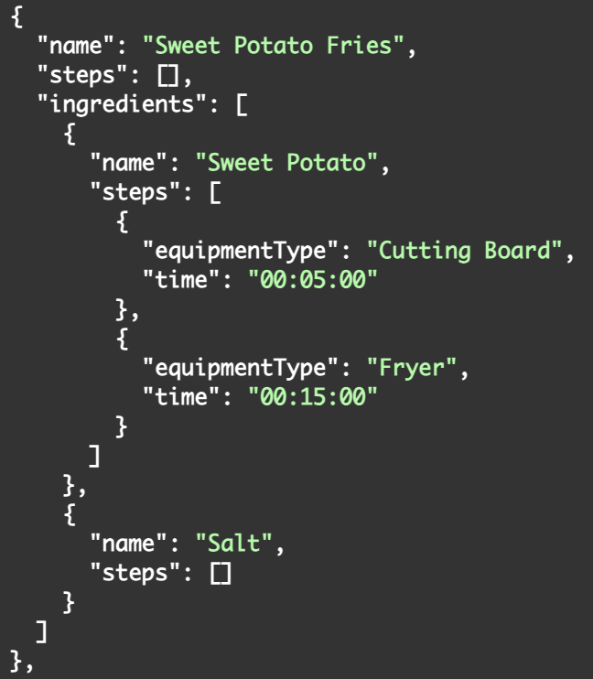
Recipes
Identical for everyone
*A recipe can also be the ingredient to another recipe!

Slide 9
Pantry

Slide 10
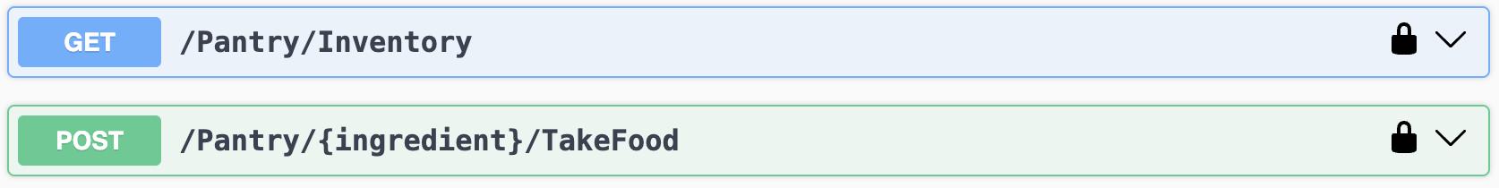
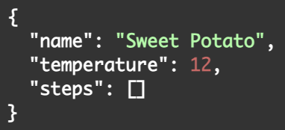
Pantry
Identical for everyone
Unlimited supply
Notes:
Unlimited

Slide 11
Equipment

Slide 12
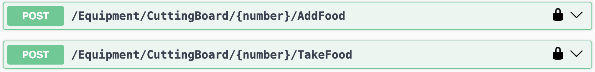
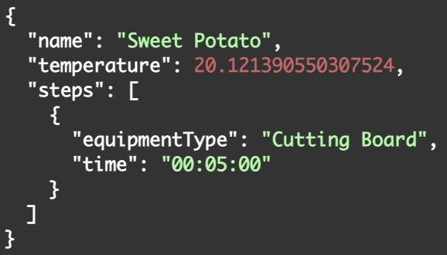
Equipment
Shared between everyone in a kitchen
When you take the food, you basicly mix all the added ingredients
Number is zero-based
*In case you make an unknown combination, you get an “UNKNOWN MIXTURE”
Notes:
Unlimited

Slide 13
Timers

Slide 14
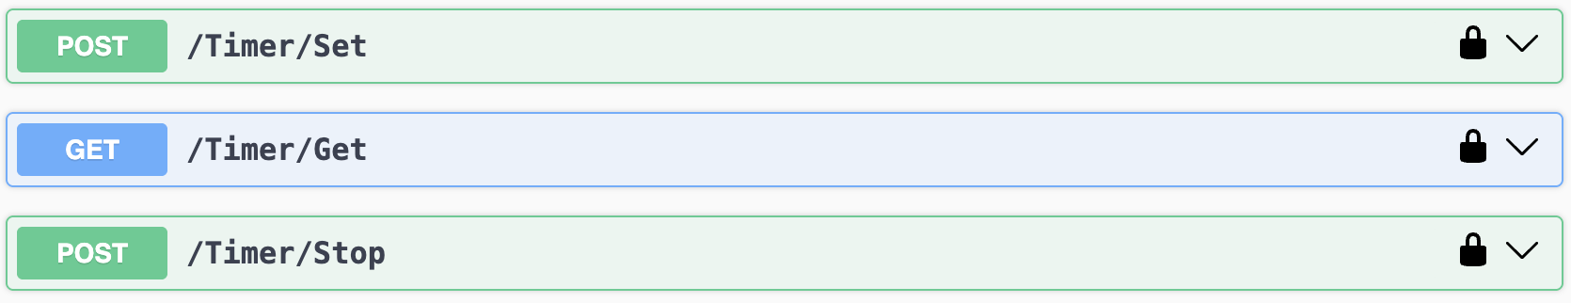
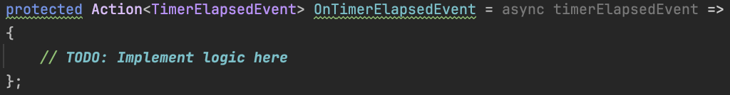
Timers
Timers are personal
Unique number for each cook
*In case a timer elapses, you keep repeatedly receiving the event until you stop the timer
Notes:
Unlimited

Slide 15

Communication

Slide 16
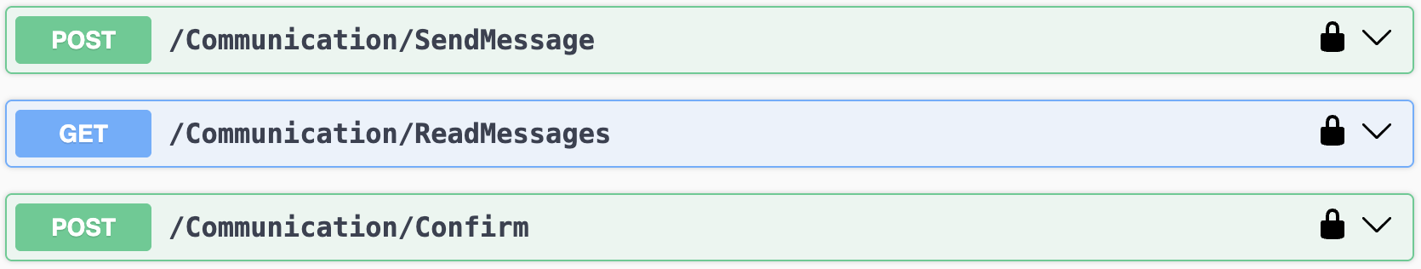
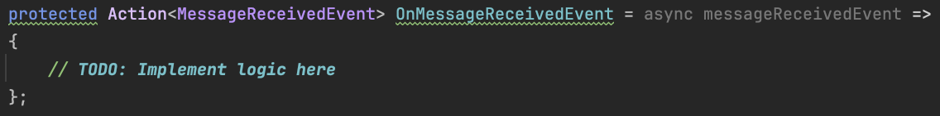
Communication
Message can be directed to another cook or everyone
To = username other cook directs the message to that cook
To = null directs the message to everyone except yourself
Unique number for each cook
Notes:
Unlimited

Slide 17
Trash

Slide 18

Trash
Simply throw away the food you are currently holding
Notes:
Unlimited

Slide 19
Rating

Slide 20
Rating
Your kitchen will be rated on three factors:
How long it takes to deliver food, the rating will go down if food starts to take too long (always with preparation times in mind)
Completeness of the orders
How well you followed the recipes
Notes:
Unlimited

Slide 21
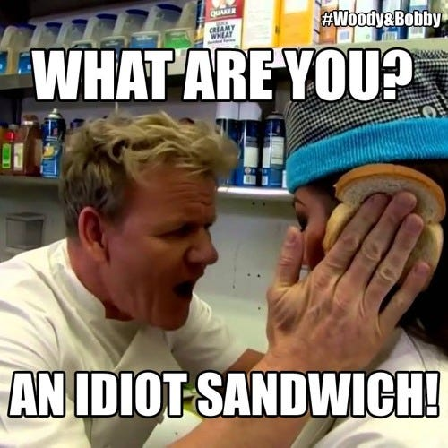
Questions?

Slide 22




@involved_it
Veldkant 35C, 2550 Kontich

